Slide 1
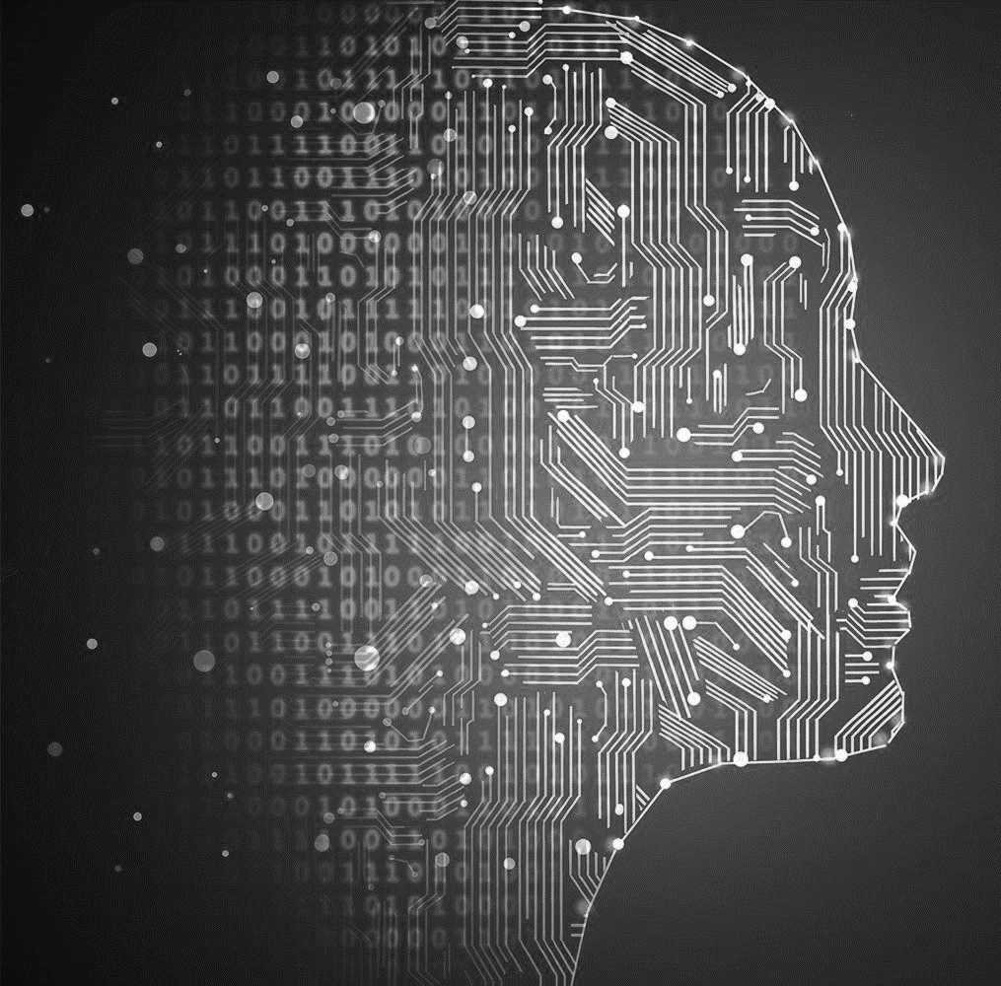
Introduction to NLP
Advanced Deep Learning Techniques
Dr. Eyal Kolman

Slide 2
NLP (Natural Language Processing) is hard
Machine Translation:
“The spirit is willing, but the flesh is weak [Matthew 26:41]”
English → Russian → English
“The vodka is good, but the meat is rotten”

Slide 3
NLP History and Branches
Conversational Bots
1950: Turing Test
Turing’s prediction to 2000:
5 min talk
30% mistakes
2014: Eugene Goostman, a 13-year-old Ukrainian boy, passed the test (33%)

Slide 4
NLP History and Branches
Conversational Bots
1950: Turing Test
Turing’s prediction to 2000:
5 min talk
30% mistakes
2014: Eugene Goostman, a 13-year-old Ukrainian boy, passed the test (33%)
Current LLMs clearly pass the Turing test, right?

Slide 5
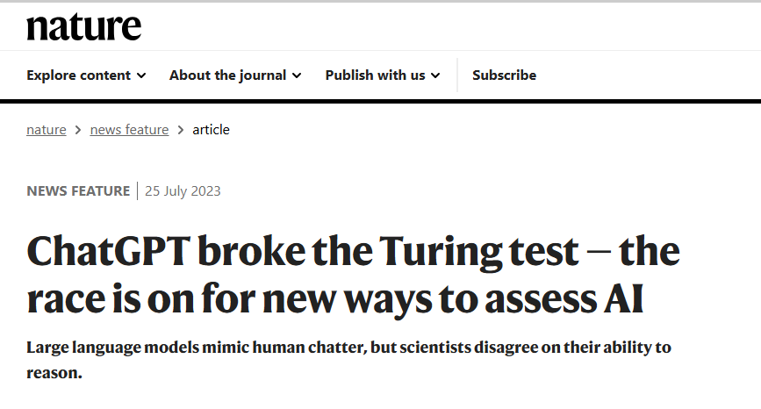
NLP History and Branches
Conversational Bots
1950: Turing Test
Turing’s prediction to 2000:
5 min talk
30% mistakes
2014: Eugene Goostman, a 13-year-old Ukrainian boy, passed the test (33%)
Current LLMs clearly pass the Turing test, right?

Slide 6
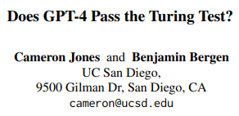
NLP History and Branches
Conversational Bots
1950: Turing Test
Turing’s prediction to 2000:
5 min talk
30% mistakes
2014: Eugene Goostman, a 13-year-old Ukrainian boy, passed the test (33%)
Current LLMs clearly pass the Turing test, right?
Gpt3.5: 20%
Eliza: 22%
GPT4: 50%
Real humans: 66%
“Participants’ decisions were based mainly on linguistic style (35%) and socio-emotional traits (27%), supporting the idea that intelligence is not sufficient to pass the Turing Test.”
October 2023

Slide 7
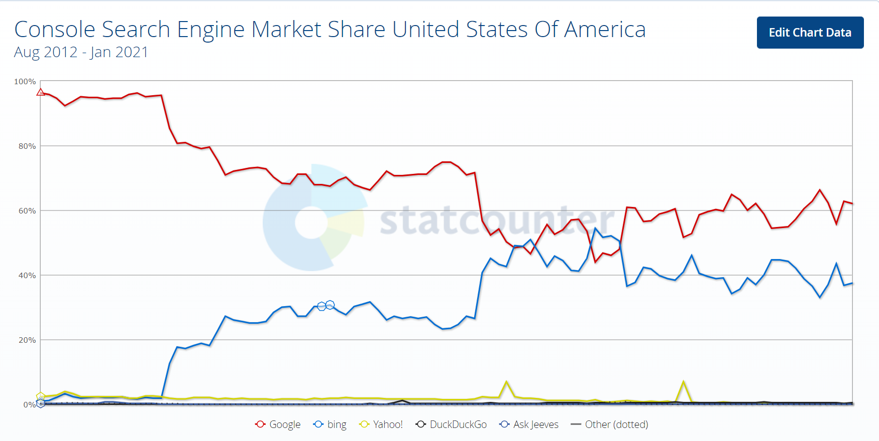
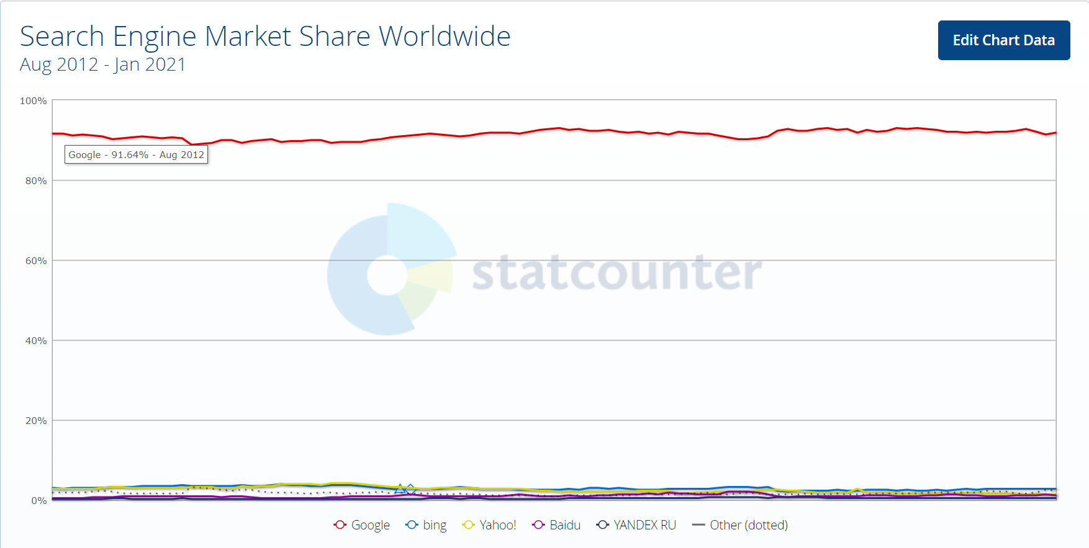
NLP History and Branches
Conversational Bots
Information Retrieval (aka Search Engines)

Slide 8
NLP History and Branches
Conversational Bots
Information Retrieval (aka Search Engines)
Text classification
Text generation
Summarization
Questions answering

Slide 9
NLP History and Branches
Machine Translation
1954: Georgetown experiment, 60 words, Russian → English
ETA: 3-5 years
1960’s: Little progress, funding was cut
Problems: Homographs, Metaphors, Irony (Poe’s law)

Slide 10
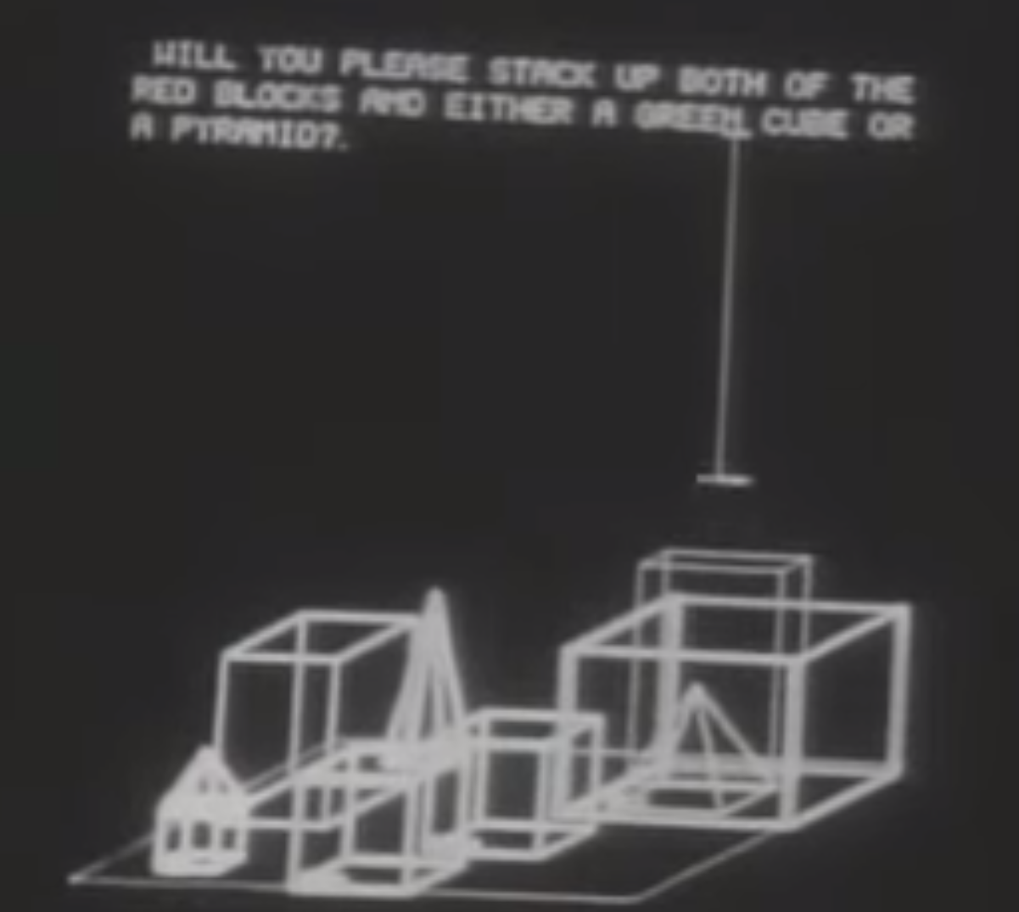
NLP History and Branches
1960’s:
SHRDLU

Slide 11
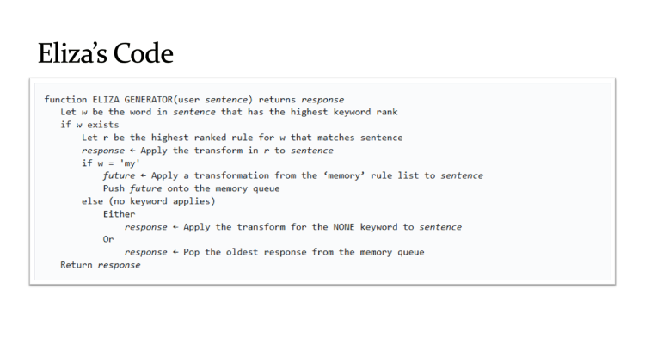
NLP History and Branches
1960’s:
SHRDLU
ELIZA
sense is required

Slide 12
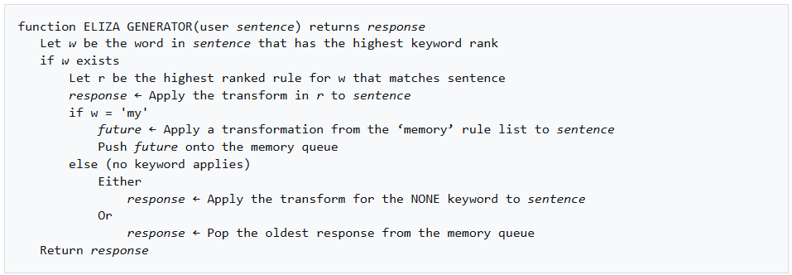
Eliza’s Code

Slide 13
NLP History and Branches
1960’s:
SHRDLU
ELIZA
1970’s: Ontologies (terms and relationships)
1980’s: Handcrafted rules
Example: Uninterested → Un (Negative prefix from list), interest (stem), ed (past suffix from list)
Problems:
Generates syntax, not semantics
People do not talk/write properly
Many exceptions sense is required

Slide 14
NLP History and Branches
1990’s: Statistical NLP or ML
Statistical models (like HMM)
Large labeled datasets for train and evaluation
Approximations instead of understanding
Automatically extracted patterns (e.g., decision trees), not crafted

Slide 15
NLP tasks
Low level NLP
Sentence breaking
Tokenization
Parts-of-speech tagging
Stemming and Lemmatization
Chunking (tokens to phrases)
Segmentation
…
Mid level NLP
Spell correction
Synonyms
Acronyms
NER: Named Entity Recognition
Relationship extraction
…

Slide 16
Basic NLP concepts: Standard Models
SVMs for classification
HMMs: Hidden Markov Models
The Markov assumption

Slide 17
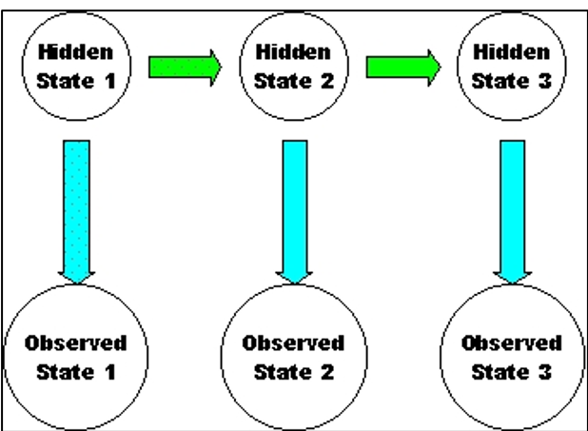
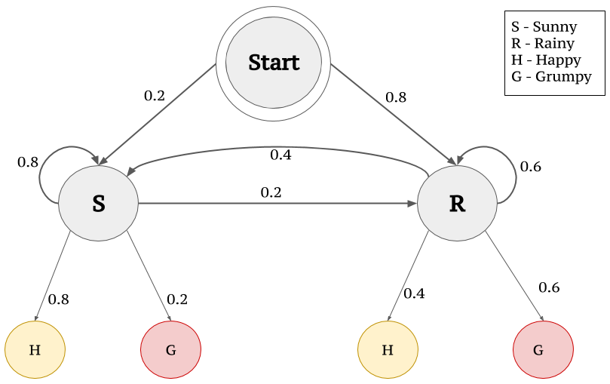
Hidden Markov Models
HMM:
States + Transition probabilities
Observations + Emission probabilities
Assumptions:
State x_{t} depends only on state x_{t-1}
Observation y_{t} depends only on state x_{t}
Example:
Speech-to-text
Weather

Slide 18
Basic NLP concepts: N-grams
Sequence of N items
Characters
Common: Qu
Rare: Tk
Tokens
Usage
Auto-completion
Spell correction
Homophones Disambiguation: To? Two? Too?
Grows exponentially with N
Google n≤5 N-grams was 28GB

Slide 19
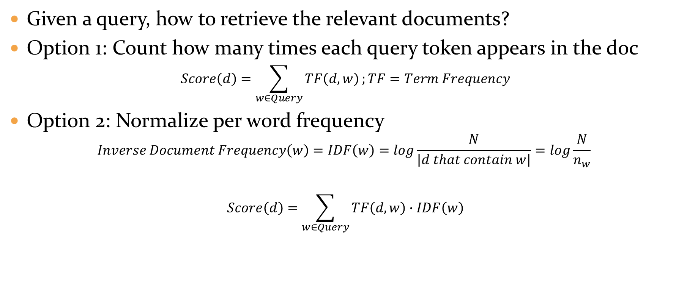
Basic NLP concepts: TF-IDF
Given a query, how to retrieve the relevant documents?
Option 1: Count how many times each query token appears in the doc
$$Score\left(d\right)=\sum_{w∈Query}{TF\left(d,w\right)};TF=Term Frequency$$
Option 2: Normalize per word frequency
$$Inverse Document Frequency\left(w\right)=IDF\left(w\right)=log\frac{N}{\left|d that contain w\right|}=log\frac{N}{n_{w}}$$
$$Score\left(d\right)=\sum_{w∈Query}{TF\left(d,w\right)∙IDF\left(w\right)}$$

